Slide 1



TEAM MEMBERS
Urvesh Patel
Rozzel LeGrande
Nebiyu GIrma
Erin Escobar
Professor: Joseph T Cipolla Department: Info Systems

Slide 2
Our Problem
To find the effect of social media on the amount of donations received over the years.
Has there been an increase in fundraising over the years because of the brand awareness created on social media as well as hosting the website?
Can we visualize the correlation among them?

Slide 3
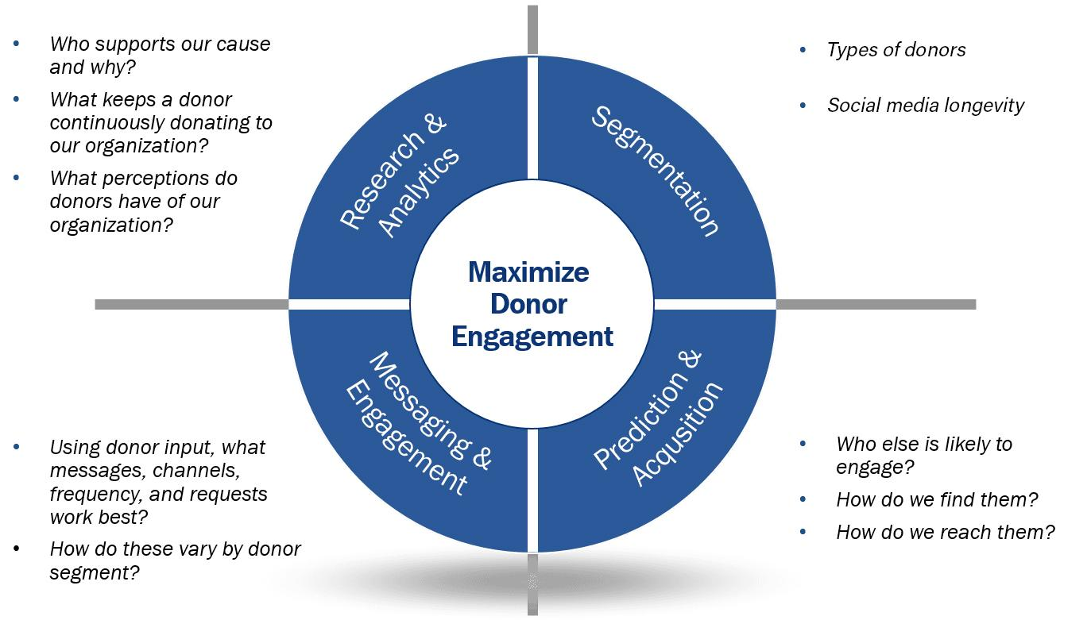
Predictive Analytic
Appendix #1
Source: Luke, Marketing & Fundraising Analytics.

Slide 4
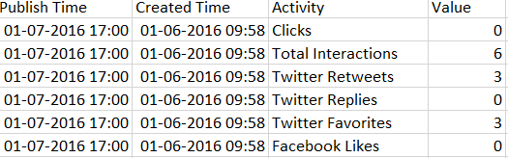
Our Approach
Cleaning the Data
Deleting unwanted rows and columns
Deleting null rows
Normalizing the data
Renaming columns
Cleaned Data

Slide 5



Our Solution
Show a trend between the amount donated and the various social media statistics.
We also use the statistics provided to show the impact created by the hosted website on the amount donated.
Our Ideation: Use of outside datasets provided by Teradata & Hire Heroes
Software Used: Tableau, Tableau Prep, Microsoft Excel

Slide 6
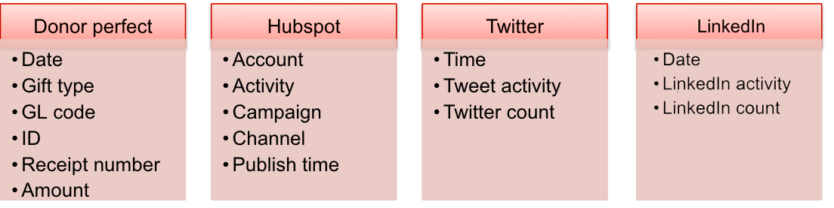
Outside Datasets
Sample text
Appendix #2

Slide 7
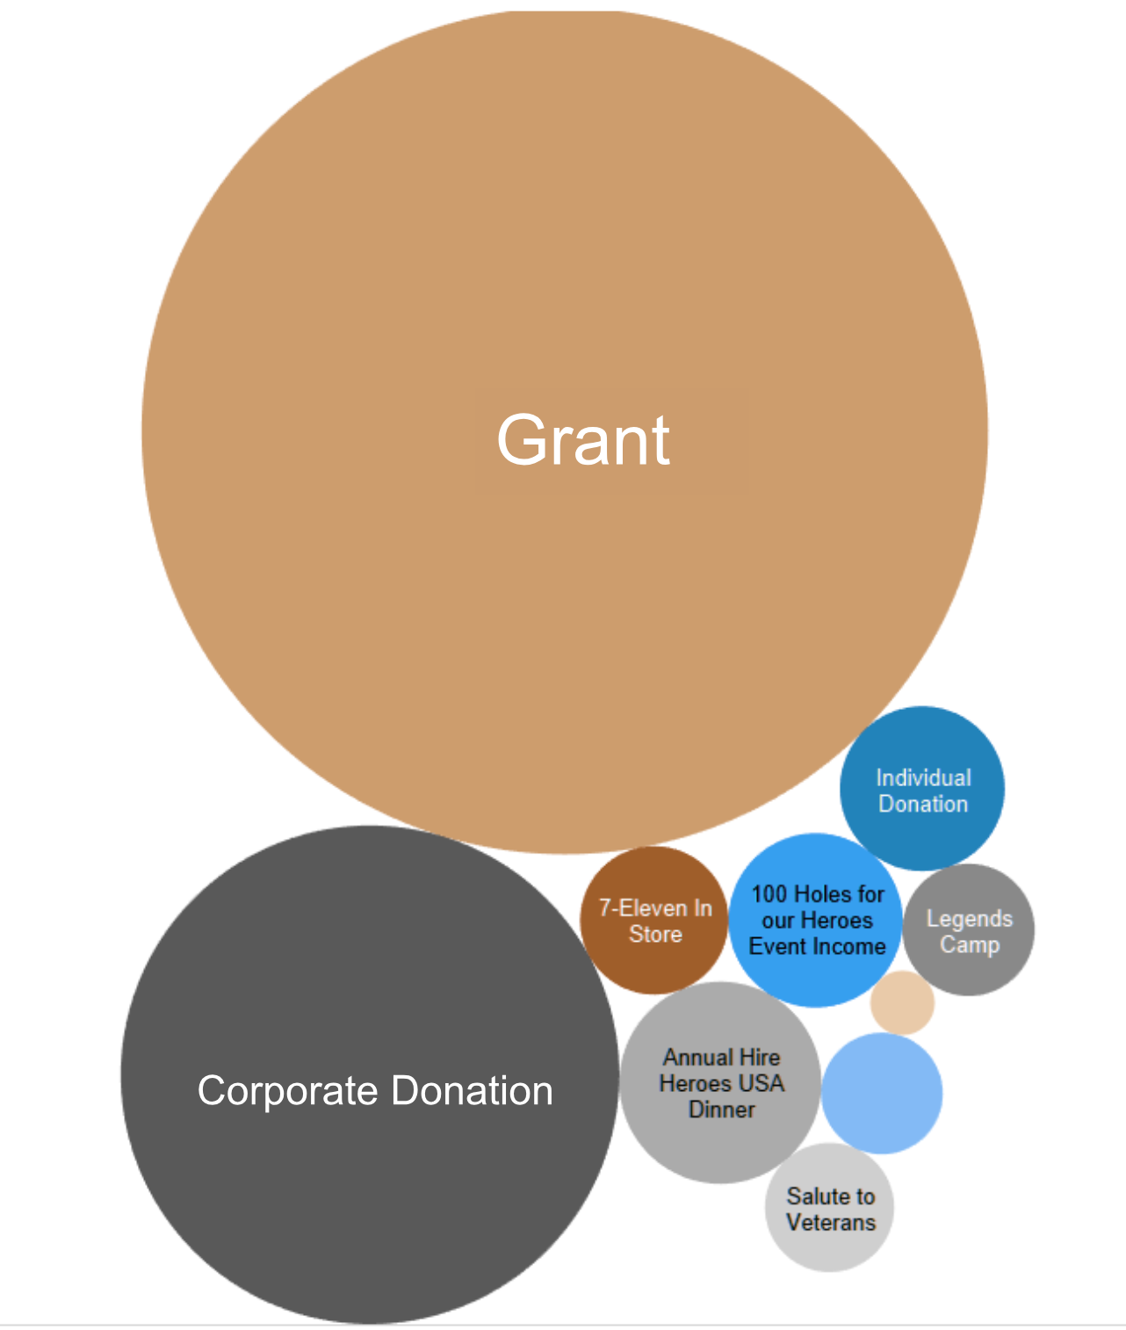
Type of Donations
Appendix #3
Most of the amount is coming as “Grants” in the form of funds by the government. (This was not social media related data, so we ignored those grants)

Slide 8
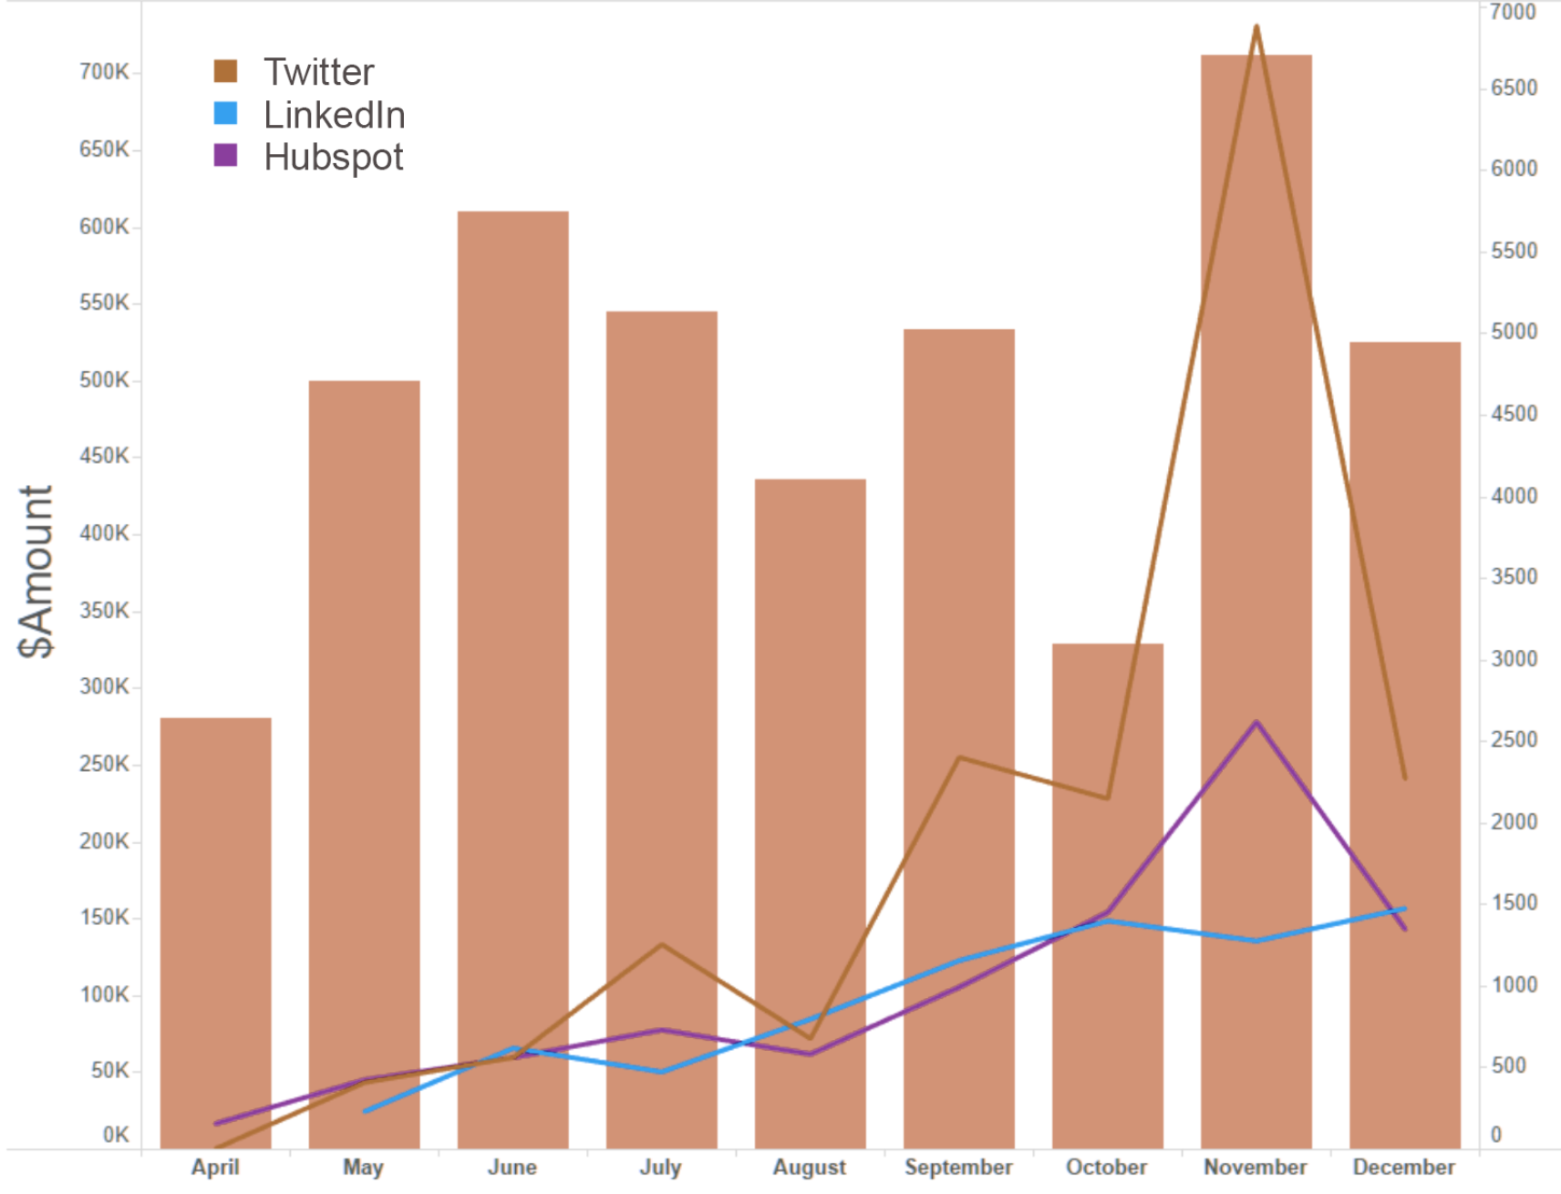
Appendix #4
Twitter
HubSpot
LinkedIn

Slide 9
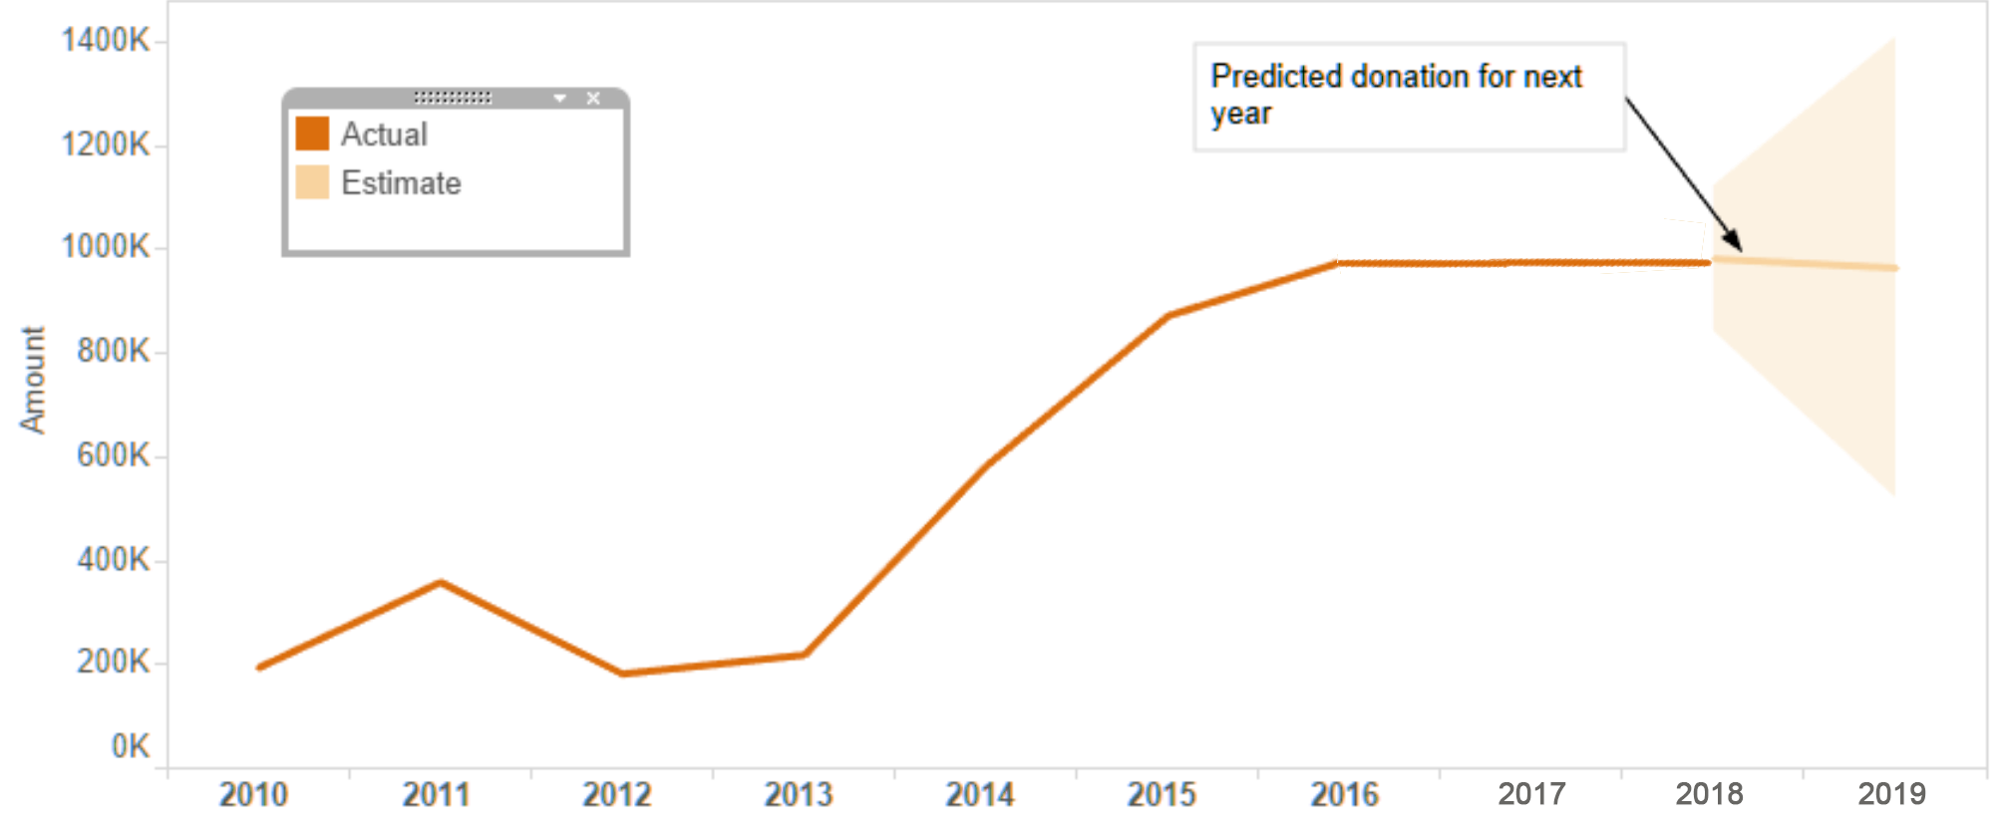
Donation Trend & Forecast
From the available data, donation prediction for year 2019
would be around 1000K excluding grants.
Our Prediction for 2019
Appendix #5

Slide 10
Our Recommendations
Continue focus on the Twitter outreach since that’s the social media platform with the most donations.
Evaluate why LinkedIn has an uneven ratio of outreach to donations because that is one market that could be huge for them.
Figure out why other social media platforms perform poorly than others, and have a strategy in place to try and solve those issues.

